Slide 1

AP EUROPEAN HISTORY · COURSE DECK
Nationalism
in Nineteenth-Century Europe
From the Congress of Vienna to Versailles — language, land, blood, and empire
1815 — 1914
PARTS ONE & TWO · COMBINED EDITION
01 / 39
Companion to Merriman, A History of Modern Europe

Slide 2
PART I · A WORKING DEFINITION
What is Nationalism?
In the nineteenth century nationalism was defined by language and cultural traditions — the quest to establish national states whose borders would correspond to patterns of ethnic residence.
A CORE PROBLEM
The Habsburg empire alone held eleven major nationalities — including Hungarians and Poles, both previously independent states.
The Congress of Vienna in 1815 had redrawn a conservative post-Napoleonic order that ignored these languages — everywhere in Central and Eastern Europe nationalists challenged that settlement, hoping to redraw borders on the map of peoples.
Merriman 570 – 571
PART I · 02 / 39

Slide 3
PART I · A QUIET SUCCESS
Switzerland: the Exception
One place quietly worked: where the Congress of Vienna tolerated — even codified — a federal compromise between language groups.
A FEDERATION
A LONG TRADITION
A LIBERAL CONSTITUTION
The Congress of Vienna established Switzerland as a federation of semi-autonomous cantons.
A long tradition of decentralised government — not granted, but inherited.
The Congress tolerated a relatively liberal constitution — the rare Metternich concession.
Each canton retained its own laws and assemblies; the central diet handled only what cantons pooled.
Swiss valleys had governed themselves for centuries before Vienna handed the seal.
Local democracy, civic militias, and cantonal sovereignty: a model other nationalists later envied.
Merriman 600 – 605
PART I · 03 / 39

Slide 4
PART I · 1830 TO 1848
Switzerland Divided, then United
SPARKED BY THE 1830 FRENCH REVOLUTION
Inspired by Paris, Swiss reformers demanded: freedom, efficient government, and limits on the clergy, both Catholic and Protestant.
METTERNICH COUNTERS
Metternich had Austria pressure the German-speaking Swiss to oppose secularisation.
01
Freedom
02
Efficiency
03
Secular limits
After limited fighting, 1848 brought a new liberal constitution.
A patchwork of valleys had answered the centralising pressure from the east with restraint — and survived. Few places in Europe could say the same in 1848.
Merriman 600
PART I · 04 / 39

Slide 5
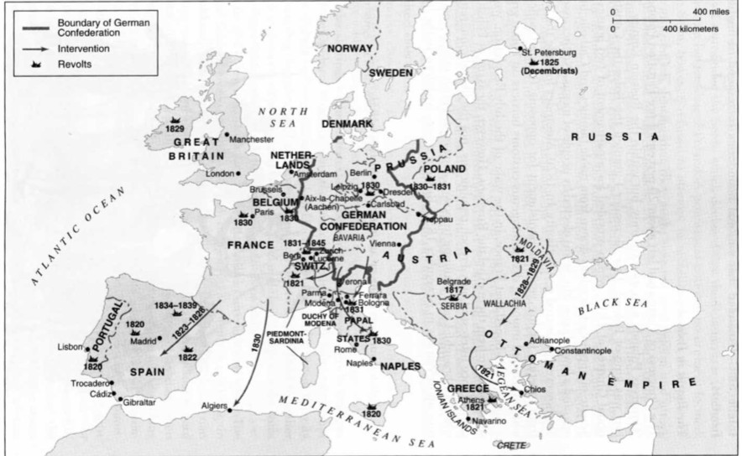
PART I · A FORCE TAKES HOLD
Nationalist Dreams Take the Map
Nationalism gradually emerged as a force for change across Central and Eastern Europe in the 1820s and 1830s.
Spain
1820 · 1822 · 1834–39
France · Belgium · Poland
1830 · 1830 · 1830–31
Greece · Decembrists
1821 · 1825
Europe, revolts and interventions 1820s–1840s. France → Spain 1823–28; Algiers 1830; Russia 1828–29.
Merriman 600 – 603
PART I · 05 / 39

Slide 6
PART I · POLAND
Poland: Congress Poland
THREE FACTS, 1815
~20%
Kept its own army, but lived inside the Russian Empire.
A 1815 Charter gave a two-house parliament — with no real power.
of pre-Partition Poland, kept under Tsarist rule after 1815
By 1820 even this fig-leaf was being punished — by Alexander I.
A kingdom in name, a garrison in practice — the seedbed of revolt was already planted.
Merriman 602
PART I · 06 / 39

Slide 7
PART I · POLAND · 1830–32
Poland Rises Up
Some looked to France to help expel the Russians — but the liberal monarchists who brought Louis-Philippe to power in 1830 had no interest in Poland.
THREE MOVES
THE VACUUM IN THE WEST
1830
Polish military cadets rise against the Russians.
Poland did not interest the July Monarchy. French liberals did not ride to Warsaw, and the revolt stood alone.
1831
A provisional national government is formed.
The revolutions of 1830 fired one another across Europe — but only the ones with a patron nearby survived.
1832
The Tsar’s troops surround Warsaw.
Merriman 602 – 603
PART I · 07 / 39

Slide 8
PART I · POLAND · AUTUMN 1832
Poland Falls Again
10,000
THE AFTERMATH
Autumn 1832: Warsaw falls to the Russians. Polish privileges disappear. The revolt is over.
Poles fled Russian oppression — carrying culture westward
Artists and musicians enriched Western European cities.
National memory survived in exile: music, poetry, salon politics.
Frédéric Chopin
1810 – 1849
Moved to Paris to make his “fortune” — among the artists and musicians who enriched Western European cultural life.
Poland would rise again in 1863 — and fail again.
The state on the map was gone; the nation in the mind was not.
Merriman 602 – 603
PART I · 08 / 39

Slide 9
PART I · ITALY & SPAIN
Italy and Spain Rise Up
CENTRAL ITALY DECLARES
“United Provinces of Italian States” — several central Italian cities declared independence.
ITALY · BOLOGNA & MODENA
PARMA · LOCKED OUT
AND SPAIN?
Movements began over the inefficient, corrupt rule of local princes — not yet about national unification.
Citizens of Parma locked the Duchess out of the city — the small humiliations multiplied.
Massacre of the garrison at Madrid would set off a deeper quarrel — liberal resistance against the restored Bourbon order.
Local grievances and the wider idea of the nation were already beginning to fuse — soon, a young Genoese lawyer would give that idea a name and a method.
Merriman 603
PART I · 09 / 39

Slide 10
PART I · THE LIBERAL REVOLUTIONARY
Giuseppe Mazzini
1805 — 1872
A trained lawyer. An energetic revolutionary. The man who wanted to bring peace to Europe by liberating all people.
Lawyer of Genoa
Propagandist
Visionary
born into the bourgeoisie of an occupied peninsula
voice of Young Italy, writing across Europe
a federation of European democratic republics
HIS DREAM
A federation of European democratic republics — free peoples, voluntary unions, no dynasties.
Merriman 603
PART I · 10 / 39

Slide 11
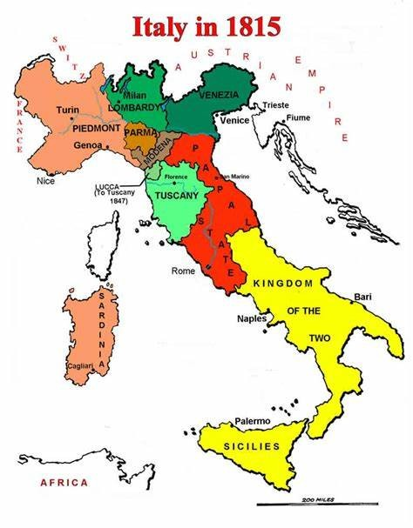
PART I · THE STRONGEST STATE
Piedmont-Sardinia
The strongest Italian state of 1815 — the only one with the army, the bureaucracy and the will to challenge Austrian domination of the peninsula.
Strongest state but Austria dominates the peninsula.
Unification remains a dream of middle-class intellectuals.
A laboratory where statecraft later overtakes poetry.
Italy in 1815 — Sardinia, Lombardy-Venetia, Parma, Modena, Tuscany, the Papal States, and the Two Sicilies.
Merriman 603 – 604
PART I · 11 / 39

Slide 12
PART I · GERMANY
German Nationalism: Weak Liberals
German liberals had a hard job in the German states. Then in 1830 things began to change.
THREE HANDCUFFS
1830 – THEN THINGS BEGAN TO CHANGE
Const. weak or gone
In 1831 German university students, hearing of events in Poland, began to imagine a politics of their own.
almost nowhere guaranteed
Franchise limited
voters were a thin slice
Assemblies toothless
French July Revolution, Polish revolt, Belgian independence — a continental wind behind a hundred small publications, reading rooms, and burschenschaften.
consulted at royal pleasure
Yet unification was still a generation away. The German liberals would have to learn a longer game.
Merriman 603
PART I · 12 / 39

Slide 13
PART I · THE VORMÄRZ
Young Germans, Hegel & the Zollverein
Liberalism slowly gained momentum with professors, students, and lawyers in the “Before March” period. The 1830 French Revolution was an influence. As German liberalism became linked to the pursuit of German unification, one philosopher would put it explicitly.
THE CUSTOMS UNION
Zollverein
CREATED 1834
Free trade among the German states — a customs union that quietly assembled an economic nation before the political one ever came.
Georg Wilhelm Friedrich Hegel
1770 – 1831
The state as the march of Spirit through history — philosophy gave the German liberal-national cause its most ambitious vocabulary.
Liberalism and nationalism were, briefly, the same thing in Germany.
Merriman 604 – 605
PART I · 13 / 39

Slide 14
PART I · SUMMARY
Nationalism 1820 – 1850
Liberals and nationalists challenged the conservative post-Napoleonic settlement — and gained ground.
German states
Northern Italy
Habsburg domains
Professors, students, lawyers. Zollverein 1834. Unification a generation away.
Mazzini, Young Italy, secret societies, the peninsula dreaming of itself.
Czechs, Serbs, and others began to imagine their own national questions.
THE KEY SHIFT
In the first half of the 19th century, nationalism was identified with the political left — liberals and nationalists were often the same people.
Merriman 646 – 647
PART I · 14 / 39

Slide 15
PART I · THE TURNING
The Rightward Turn
By the end of the century, nationalists were convinced their people were superior to any other. Ideology now championed by the right wing.
RIGHT WING
SUPERIORITY
ANTI-SEMITISM
A new political family for an old word — state, army, church, exclusion.
The nation as a chosen people — and chosen people deserve an empire.
Fed off aggressive nationalism — an old prejudice given a modern, political vocabulary.
The same word, “nation,” now answered to different masters.
Merriman 646 – 647
PART I · 15 / 39

Slide 16
PART I · EMPIRE & RIVALRY
Nationalism Merges with Imperialism
ENTITLED TO DOMINATE
¾
Right-wing nationalists were entitled to dominate “inferior” peoples through the expansion of empire.
A LINE FROM HERE TO 1914
of the world, divided among the powers by 1914
“New Imperialism” begins in the 1880s.
Europe splits in two: Germany + Austria-Hungary vs Britain, France, Russia.
Fueled by the Russo-Austrian rivalry over nationalism in the Balkans.
A WORLD DIVIDED
Nationalism no longer talked of constitutions. It talked of spheres of influence.
Merriman 646 – 647
PART I · 16 / 39

Slide 17
PART I · THE HABSBURG PROBLEM
The Dual Monarchy: Why
The Habsburg empire kept losing in battle — in 1866 to Prussia. The Magyars (Hungarians) demanded more power. Emperor Francis Joseph needed them — or he could not begin a war of revenge.
DEFEAT
PRESSURE
SO
1866
Hungarians demand more political power.
A dual monarchy — and a quiet revolutionary settlement.
→
→
Lost to Prussia — the old imperial order humiliated on the battlefield.
A people too numerous and too organised to govern without concession.
Until Hungary was cooperative, Francis Joseph could not begin a war of revenge with Prussia — and so a constitutional compromise became the price of imperial survival.
Merriman 680 – 682
PART I · 17 / 39

Slide 18
PART I · AUSTRIA-HUNGARY
1867
The Compromise (Ausgleich)
A DUAL STATE
ADMINISTRATIVE LANGUAGE
MAGYAR DOMAINS
JOINT REALM
Created the Dual Monarchy of Austria-Hungary.
Hungarian becomes the language of administration in Hungary.
Their own constitution, parliament and bureaucracy.
Tariffs renegotiated every ten years; representatives of both sides to the Imperial Assembly.
Mention the Nationality Law: a state built to manage, not dissolve, the differences within it.
Merriman 680 – 682
PART I · 18 / 39

Slide 19
PART I · MANAGING THE CROWD
Unrest & Eduard Taaffe
Austria dominated the Dual Monarchy — and none of the other nationalities were happy. In the 1870s, Croatia sent five representatives to the Imperial Assembly. Every other nationality was left out.
PRIME MINISTER
Eduard Taaffe
1833 – 1895
MAGYARISATION
A MODEL FIVE
AUSTRIA, 1879 – 1893
The Hungarian government began Magyarisation of everything.
From the Croats: five — and the rest is silence.
Balanced the competing interests of the varied nationalities — particularly the Czechs, the third-largest nationality.
Taaffe tried to govern by trading favours: a German here, a Czech there, a Pole somewhere else — the everyday craft of keeping a Habsburg empire stitched together.
Merriman 681 – 682
PART I · 19 / 39

Slide 20
PART I · THE SPECTRUM
In Short: the Varieties of Nationalism
Nationalists encouraged loyalty to the nation in a variety of ways — sometimes generous, sometimes poisonous.
01
02
03
04
05
Romantic idealism
Liberal reform
Political unification
Racialism
Chauvinism
the nation as soul, song, language, soil
constitutions, parliaments, citizens
Piedmont, Bismarck, statecraft
with concomitant anti-Semitism
national aggrandizement, sometimes at others' expense
Part I summary · spectrum
PART I · 20 / 39

Slide 21
PART I · JEWISH NATIONALISM
Zionism
ANOTHER NATIONALIST MOVEMENT
1.5M
Zionism — a form of Jewish nationalism — developed late in the century as a response to growing anti-Semitism across Europe. Goal: the establishment of a Jewish homeland in Palestine.
Jews left Russia and Russian Poland for the United States
1871 – 1914
Western European Jews had been acculturating through the 19th century — emancipation, citizenship, dress, language.
A people who had answered “nation” in every European language now answered it in Hebrew.
Tens of thousands more moved into European capitals — Berlin, Vienna, Paris, London.
Merriman 762 – 763
PART I · 21 / 39

Slide 22
PART I · THE BRITISH IDEA
Zionism & the British
BRITISH SUPPORT
BY 1914 IN PALESTINE
British support for the movement was cool but consistent. Palestine, formally Ottoman, hosts an early Zionist foothold by 1914.
85,000
THE BRITISH IDEA
Jews were already there — still part of the Ottoman Empire.
A Jewish state would serve as a buffer between the Suez Canal and Syria.
A LATE ANSWER, A NEW QUESTION
DIASPORA & HOMELAND
Zionism meets empire at exactly the moment when “new imperialism” maps the world.
Western Jews acculturated, central Jews emigrated east, Zionists asked for soil.
Merriman 762 – 763 (continued)
PART I · 22 / 39

Slide 23
PART I · CLOSING
After World War One
The nationality question returned — louder than before, world-wide.
REPRESENTATIVES AT VERSAILLES
A WORLD AWAKENING
Irish
Persians
The century that had begun at Vienna with five great powers — ended at Versailles with a dozen national questions, and no consensus on what to do about any of them.
Jews
Arabs
Indians
Vietnamese
Armenians
African Americans
all hoping for recognition of their natural rights.
Merriman 973 – 974
PART I · 23 / 39

Slide 24

PART II · PART TWO
1848, Unification
& the Dark Turn
where the century turns — revolutions, realpolitik, and a politics of exclusion
continued from Part I
24 / 39

Slide 25
PART II · A VOICE FROM THE NAPOLEONIC ERA
J. G. Fichte
1762 – 1814
“Johann Gottlieb Fichte was the one who called upon the German nation during the times of Napoleon.”
WHO IS A GERMAN?
A LINEAGE
He defined it as including anyone who spoke German — a culture, not a dynasty, called into being by occupation.
Fichte opens a long thread — from addresses to the “Addresses to the German Nation” to a century of rhetoric about the nation.
Merriman 503
PART II · 25 / 39

Slide 26
PART II · ITALY
Mazzini’s Plan
A European “union” of democratic states — beginning with the defeat of Austria in northern Italy.
01
A federation of democratic republics
CHARLES ALBERT
1798 – 1849
02
Begin by defeating Austria in northern Italy
King of Sardinia — Mazzini wanted him at the head of political unification.
03
Support Charles Albert of Piedmont-Sardinia as leader
A continent-wide imagination, married to a peninsula-wide strategy.
Merriman 603, 625
PART II · 26 / 39

Slide 27
PART II · 1848 · ROME
1848 in the Papal States
Revolutionaries arrive
A liberal government
The Pope recoils
They challenge the authority of the Pope in the Papal States. Bishops are mocked, the temporal power is questioned.
The Pope names a more liberal government — an attempt at conciliation that history will not stretch to cover.
One minister is assassinated. The Pope calls for that very government to be overthrown.
So began a Roman year that did not quite end — the most consequential revolution of 1848 in Italy was about to declare itself.
Merriman 636 – 638
PART II · 27 / 39

Slide 28
PART II · 9 FEBRUARY 1849
The Roman Republic
PROCLAIMED
9 February 1849
THE CAPITAL IDEA
MAZZINI ARRIVES
THE HABSBURGS BUSY
Italian nationalists began to think of Rome as the centre of the country.
March 1849 — Mazzini joins the revolutionary government.
The Habsburgs could not help the Pope — too busy elsewhere.
For a few weeks it actually worked. Italy looked almost plausible.
Merriman 636 – 638
PART II · 28 / 39

Slide 29
PART II · APRIL 1850
The French Intervene
The French came to support the Pope and met Garibaldi — more strident and more organised than Mazzini.
OCCUPATION
THE VENETIAN EXCEPTION
RESET
The French occupy Rome. The Pope returns April 1850.
Only the Venetian Republic survived 1848 into 1849.
By 1851 — almost everything back to pre-1848.
A NAME ENTERS THE STORY
Garibaldi was more strident and more organised than Mazzini — he would, in time, become the other face of Italian nationalism.
Merriman 636 – 638
PART II · 29 / 39

Slide 30
PART II · APOSTLE OF UNIFICATION
Mazzini after 1848
In mourning until unification could be achieved. Rejecting both liberalism and socialism. Resolute.
REJECTION
REJECTION
AFFIRMATION
Classic liberalism, for him, was devoid of moral values.
Socialism he dismissed as overly materialistic, missing the moral pole.
Unification would have to be the work of the people themselves — not just the expansion of Piedmont-Sardinia.
Merriman 652 – 653, 656
PART II · 30 / 39

Slide 31
PART II · PLANS WITHOUT ARMIES
Try Again
1853
1854
Plans an insurrection in Lombardy. The Austrians are tipped off. Mazzini’s propaganda keeps the question alive in diplomatic circles.
Cavour offers Piedmont-Sardinia’s alliance to Britain and France in the Crimean War. Mazzini sees it as irrelevant.
TWO ITALIES, TWO METHODS
Mazzini’s visionary Italy and Cavour’s administrative Italy were about to converge — only one of them would actually make the country.
Merriman 652 – 653, 656
PART II · 31 / 39

Slide 32
PART II · THE COLD TRUTH
In Short: How Italy Unified
THE ANSWER THE EXAM WANTS
Italian unification came not from Mazzini’s utopian nationalism, nor from Garibaldi’s frenzied southern dashes — but largely from the expansion of Piedmont-Sardinia.
NOT POETRY
NOT CHARGE
YES, STATECRAFT
Mazzini’s utopian nationalism shaped aspirations, not borders.
Garibaldi’s southern campaigns added territory but not the political question.
Piedmont-Sardinia — the peninsula’s strongest, most liberal state — made the country.
Merriman 649
PART II · 32 / 39

Slide 33
PART II · THE DARK TURN
Anti-Semitism
Hostility to or prejudice against Jews. Became a unifying factor for many nationalists in the late 19th and early 20th centuries.
A DEFINITION
FUSED WITH NATION
A RESPONSE EMERGES
An old prejudice — but modernised by printed argument, by party, and by caucus.
It named who belonged and who didn’t — the nation as club.
In a few decades, Zionism will offer a national answer to a national prejudice.
Part II · a definition
PART II · 33 / 39

Slide 34
PART II · FRANCE · A CASE STUDY
The Dreyfus Affair
Put right against left. Army, Church, and monarchists against republicans and, in time, socialists. Family against family.
THE RIGHT
THE LEFT
Army · Church · monarchists
Republicans · (later) socialists
An anti-Dreyfus coalition — rapid, fashionable, loud in press and salon.
A Dreyfusard minority — writers, jurists, intellectuals who called the affair what it was.
Merriman 738 – 740
PART II · 34 / 39

Slide 35
PART II · THE MAN
Alfred Dreyfus
1859 – 1935
FAMILY
ALSACE GOES
Old Jewish family from Alsace. Peddlers, then textile manufacturers. Proudly considered themselves French.
1871
Germany annexes Alsace. The family moves to Paris.
A bourgeois family already inside the Republic.
WHAT FOLLOWS
A facsimile of the Republic: an Alsatian, a Frenchman, a Jew, a captain — accused of being none of these things at once.
Merriman 738 – 740
PART II · 35 / 39

Slide 36
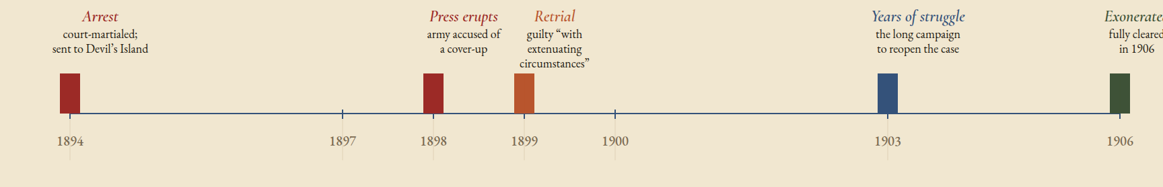
PART II · 1894 – 1906
The Dreyfus Affair: a Timeline
TWELVE YEARS, ONE CASE
High-ranking officers believed it was better to have an innocent Jew languishing on Devil’s Island than to compromise the army’s public image.
A STORY IN FIVE BEATS
Arrest · Press erupts · Retrial · Long struggle · Exoneration
Arrestcourt-martialed;
sent to Devil’s Island
Press eruptsarmy accused of
a cover-up
Retrialguilty “with
extenuating
circumstances”
Years of strugglethe long campaign
to reopen the case
Exoneratedfully cleared
in 1906
1894
1897
1898
1899
1900
1903
1906
Merriman 738 – 740
PART II · 36 / 39

Slide 37
PART II · CATHOLIC COUNTRIES
The Church vs the Modern World
In Catholic countries the Church was an alternative to nationalism. Its influence receded as state and social institutions secularised. The Pope and Rome were against nation states and parliamentary government.
1864
1870
1891
SYLLABUS OF ERRORS
PAPAL INFALLIBILITY
RERUM NOVARUM
Pope Pius IX condemns the idea that the Roman Pontiff can and ought to reconcile himself with progress, liberalism, modern civilisation.
Doctrine of papal infallibility proclaimed — a centralised voice for an embattled Church.
Pope Leo XIII (1878–1903) accepts the modern world. Calls attention to social injustice. Unintended: Christian Socialist movements in the 1890s.
An institution that began the century condemning the modern world — by century’s end was learning to live within it.
Merriman 792
PART II · 37 / 39

Slide 38
PART II · VIENNA · 1895
Karl Lueger’s Vienna
SIGMUND FREUD, BY THE WAY
THE QUOTE
Son of a Jewish wool merchant. Family business goes from bad to worse; they move to Vienna. A young analyst in an increasingly loud city.
“I decide who is a Jew.”
1867
1873
Jews get full civil rights.
Atmosphere changes — economic depression.
Karl Lueger, on becoming mayor.
The mayor of a great capital — and his constituency of small resentments — turned the politics of hate into the politics of the ballot box.
Merriman 808
PART II · 38 / 39

Slide 39

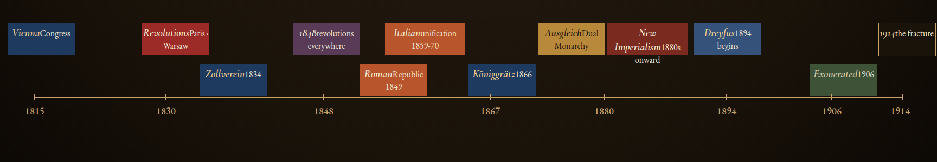
FOR THE EXAM · FIVE THINGS TO CARRY HOME
Key Takeaways
01
02
03
04
05
Left then right
Statecraft > poetry
Empire management
The dark turn
Conservative realpolitik
Nationalism’s drift from the liberal left to the right wing.
Unification: Piedmont’s expansion, not Mazzini or Garibaldi.
Ausgleich, Taaffe — ruling over peoples, not dissolving them.
Dreyfus, Lueger; Zionism as Jewish national response.
Napoleon III, Cavour, Bismarck — nationalism in service of the state.
ViennaCongress
RevolutionsParis · Warsaw
1848revolutions everywhere
Italianunification 1859-70
AusgleichDual Monarchy
New Imperialism1880s onward
Dreyfus1894 begins
1914the fracture
Zollverein1834
RomanRepublic 1849
Königgrätz1866
Exonerated1906
1815
1830
1848
1867
1880
1894
1906
1914
A century, four colors, one word that answered to every master.
end of deck
39 / 39 · END

